Slide 1
Evaluating an Ad’s effectiveness

Slide 2
Ethos
Frequently translated as some variation of “credibility or trustworthiness.”
The “speaker’s” character that is established by speech or discourse.
“Appeal to character,” the use of the speaker’s character to convince us.

Slide 3
Ethos?

Slide 4
Pathos
The elements of a “speech” that appeal to any of an audience’s sensibilities.
“Appeal to emotion,” the use of emotion to convince us.

Slide 5
Global Warming

Slide 6
Logos
How strong the logic or reasoning of the “text” is.
Appeal to logic; attempting to convince us through reason, facts, numbers, etc.

Slide 7
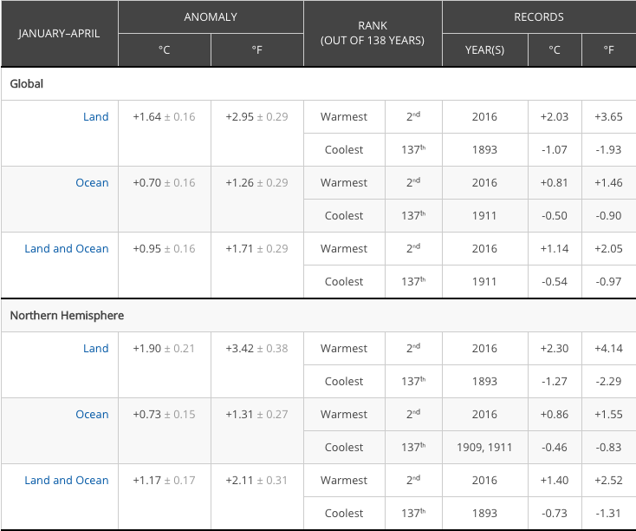
Global Warming

Slide 8
Kairos
The particular setting, time, and place that a text occurs in.
The particular setting, time, and place that a text refers to.
Cultural setting, historical setting, political setting, etc.
“Context”
A text has effective kairos when it is written ‘at the right time’
A text has ineffective kairos when it is written ‘at the wrong time.’
“TOO SOON!”

Slide 11
Telos
The particular purpose or attitude of a text.
The text’s goal.
An advertisement has two goals:
Sell a product.
Spread an ideology.

Slide 14
Advertisement example
https://www.youtube.com/watch?v=73P9STckPLw

Slide 15
Kairos
The recent protests across the US that have occurred in the past year or so, often over alleged police brutality and the failure of bad cops to be adequately punished by the law.

Slide 16
Telos
An advertisement has two goals:
Sell a product.
Spread an ideology.
Partial telos of the advertisement: sell Pepsi.

